Slide 1

Deep Learning Final Project
James Wang

Slide 2
Outline
Part 1 CIFAR-10 Image Classification
Dataset Information
Labels
Creating the CNN
Results
Part 2 AI Blackjack Player
States
Actions
Rewards
Layers and Activation Functions
Strategy

Slide 3

Part 1 cifaR-10 Image Classification

Slide 4
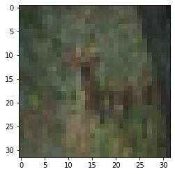
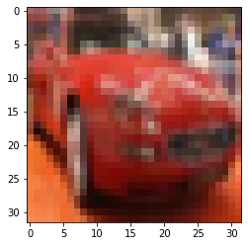
Dataset Information
CIFAR-10 is a subset of the 80,000,000 image dataset that was collected by researchers.
Images associated with a keyword were downloaded directly from the internet
This subset contains 60,000 images. 50,000 images are used as training data and 10,000 images are used for testing data
There are 10 different classes, so there are 5000 images that correspond with each class.
The images provided are “tiny images”, so the pictures are represented with minimal pixels.

Slide 5
Labels
Number | Label
0 | Airplane
1 | Automobile
2 | Bird
3 | Cat
4 | Deer
5 | Dog
6 | Frog
7 | Horse
8 | Ship
9 | Truck

Slide 6
Creating the Cnn
Model was created with 32 convolutional filters with a 3 x 3 size and RELU activation function
A 2 x 2 pooling function was then added
Another 64 convolutional layer with a RELU activation function was added
Another 2 x 2 pooling function with a dropout of .25 was added
The model was then flattened
Dense function of 10 added
A softmax activation function was added for the classification task

Slide 7
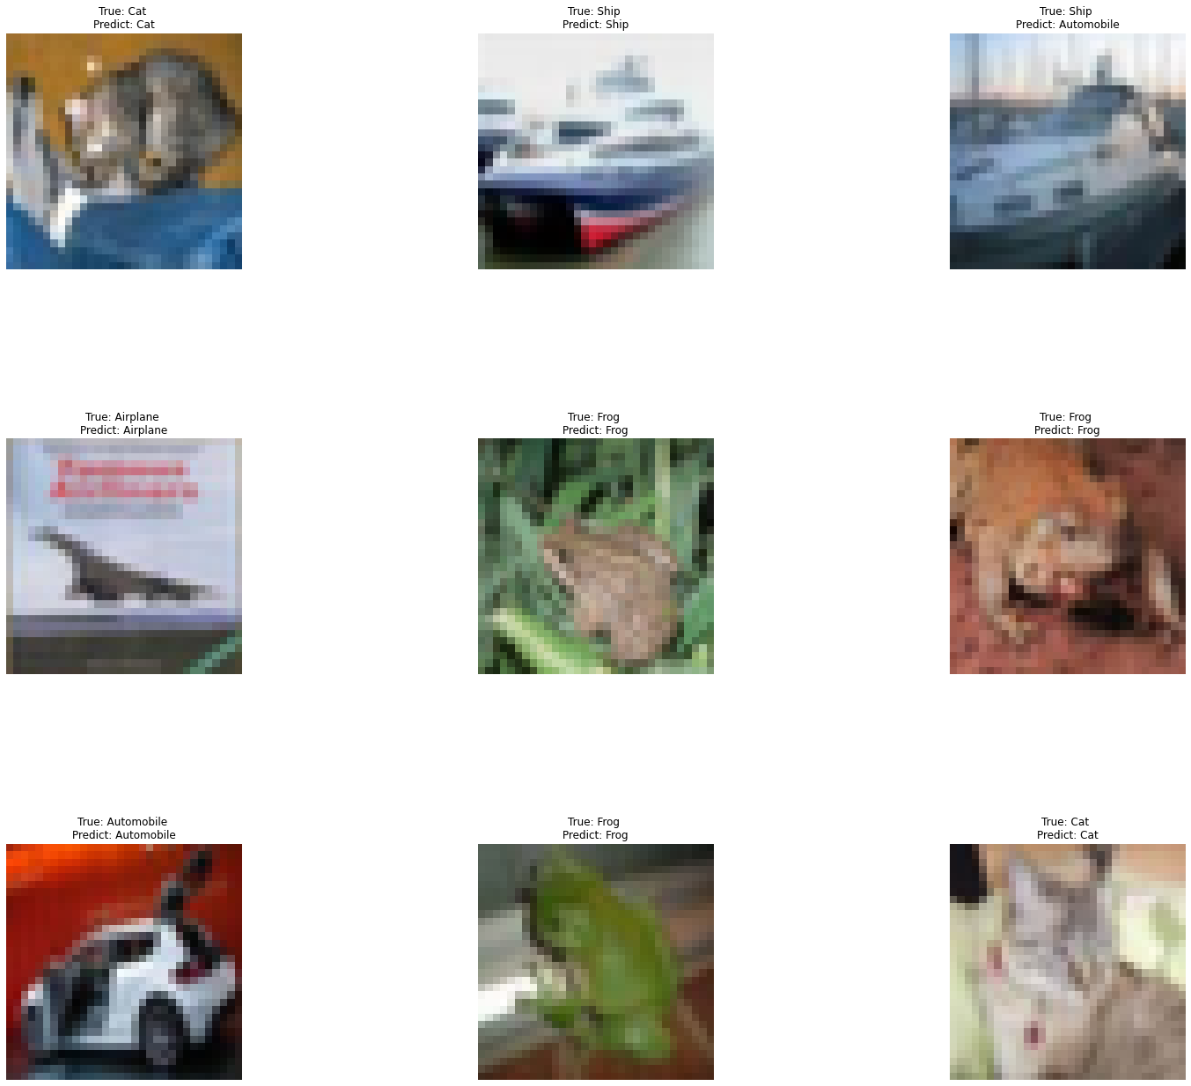
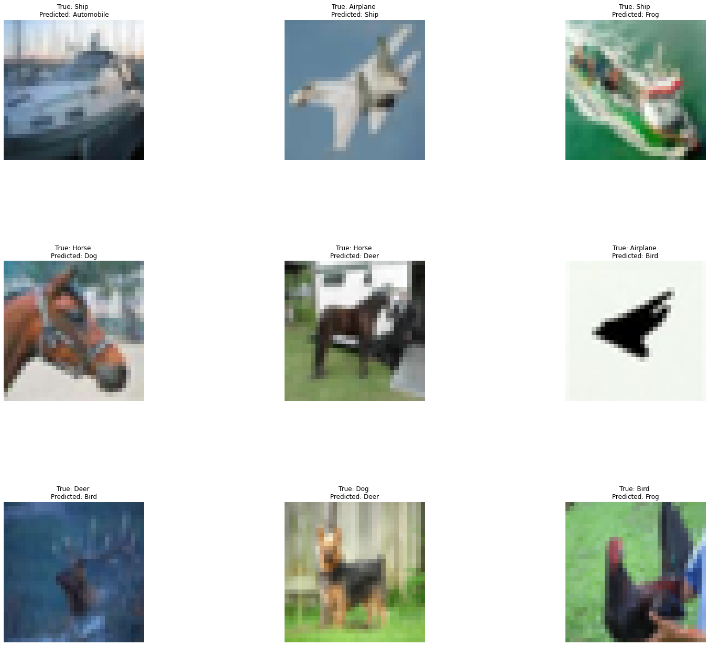
Results

Slide 8
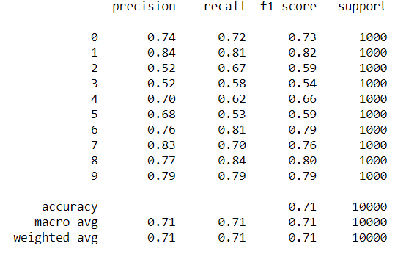
Results continued
Overall accuracy was .71, so the model was able to decently classify the different images
Some images were better classified than other images
Image Classifications (F1 Score: .7+)
Airplane (0), Automobile (1), Frog (6), Horse (7), Ship (8), Truck (9)
Image Classification (F1 Score .7-)
Bird (2), Cat (3), Deer (4), Dog (5)
Modes of transportation seem to be easier to identify than different animals.

Slide 9
Part 2 AI Blackjack Player

Slide 10
States
Initial Dealings State
Player can buy in to the game with an initial dollar amount.
Dealer distributes 2 cards to each player as well to the dealer himself.
Dealer will reveal one card while hiding the other card.
Dealer checks if he/she has a natural blackjack.
If player also has natural blackjack, then player will draw and receive initial bid back.
If player does not have a natural blackjack, then player will lose initial bid.
Skip to end state.
Active Playing State
Player performs action
Player can split and hit until the player decides to stay.
Player can hit until the player decides to stay.
Player can double and receive card.
Dealer Playing State
Dealer will reveal cards
If dealer has reached a card sum of at least 17 points, then round ends.
If dealer has less than 17 points, then dealer will hit cards until the dealer has reached a card sum of at least 17 points.
End State
Money is distributed.
If the dealer’s hand is greater than the player’s hand.
Player loses money on the table.
If the dealer’s hand is equal to the player’s hand.
Player keeps bid amount for the hand.
If the dealer’s hand is less than the player’s hand.
Player gains the bid amount for the hand.
Player can stay.

Slide 11
actions
Player can choose to Hit.
1
Player will receive one card.
If the total sum of cards is greater than 21, then the player busts
If the total sum of cards is 20 or less, then the player has the option to hit again or stay.
Player can choose to Double.
2
Player will double the amount that was initially bid, then receive one card.
Player can choose to Split cards if he/she has a matching pair of cards.
3
Player will be required to add another bid for the card that is split.
Player will be allowed to choose the Hit action until the same condition is met.
Player can choose to Stay and end his/her turn.
4

Slide 12
Rewards and penalties
Reward
Player receives money for having card total greater than dealer card total.
Neutral
No reward or penalty if player card total is equal to dealer card total.
Penalty
Player will lose bid amount if player card total is greater than 21.
Player will lose bid amount if player card total is less than dealer card total.

Slide 13
Activation functions And Layers
4 nodes in input layer to correspond with 4 states
TANH activation function for hidden layers
Can correspond with positive, neutral, and negative output of the rewards
4 nodes in output layer to correspond with number of actions available to AI player
Softmax activation function used for output layer in order to determine whether the player’s hand is likely to win, draw, or lose

Slide 14
strategy
Action Rule
If the player’s total card sum is 11, then player should double.
If the dealer’s revealed card is less than a 7, then player should stay.
If the player’s total card sum is 17 or greater, then player should stay.
If the player’s hand contains a pair of 8, then player should split.
AI Player will then learn when to hit cards and when to stay based off of the rewards / penalties

